Slide 1
Azure Machine Learning
<title>
<name>

Slide 2
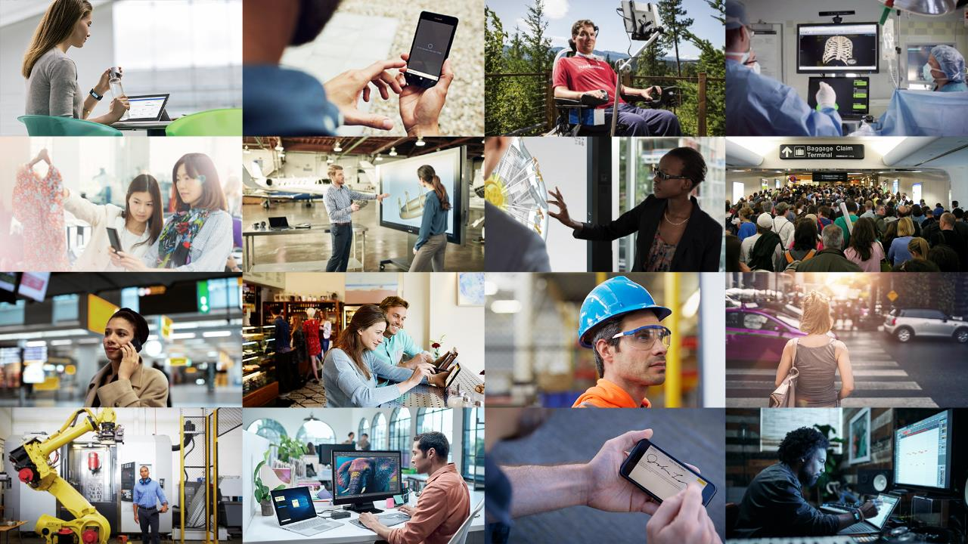
CLOUD
DATA
AI

Slide 3
Benefits of data, AI, cloud transformation
10%
NEARLY DOUBLE
operating margin
businesses commercializing data by 2020
$40k
$100M
more revenue per employee
50%+
higher average net income on revenue
The most digitally transformed enterprises generate on average $100 million in additional operating income each year
Source: Keystone Strategy 2016
Notes:
As you heard from these CEOs, across many industries – all see impact of digital tech on their business, their industry, their customers
When we talk about digital transformation, we’re really talking about DT outcomes – our opportunity is to help every customer build their digital capability into every aspect of their business to drive these outcomes

Slide 4
Microsoft AI Platform
LOB
Cloud
CRM
Graph
Image
FAST & AGILE
AI BUILT-IN
ENTERPRISE PROVEN
Social
Apps + insights
IoT
On-premises
Edge

Slide 5
Azure Machine Learning
AZURE MACHINE LEARNING SERVICES
TRAIN & DEPLOY OPTIONS
Spark
SQL Server
Virtual machines
GPUs
Container services
AZURE
AI dev /
data scientist
workstation
CPU/GPU
ON-PREMISES
SQL Server
Machine Learning Server
Experimentation and Model Management
Notebooks
IDEs
Azure Machine Learning Workbench
EDGE COMPUTING
Azure IoT Edge
Notes:
On the left we have left we have R client which offers two things to data scientists
They can leverage all the Microsoft R packages locally on their workstations
Second, they can push the compute and bid data analytics to where the data lives. This gives them access to the power of servers and eliminates need for data movement, reducing time and increasing security
On the right is our commitment of meeting customers where they are, and where their data lives.

Slide 6
Bring AI everywhere
Benefit from the fastest AI developer cloud
Build, deploy, and manage at scale
Boost productivity with agile development
Begin building now with the tools and platforms you know

Slide 7

Build, deploy, and manage at scale
Build and deploy everywhere – cloud, on-premises, edge, and in-data
Deploy in minutes with data driven management and retraining of all your models
Prototype locally then scale up and out with VMs, Spark clusters, and GPUs
Real time, high through-put insights everywhere, including Excel integration
Notes:
Build and deploy everywhere, cloud, on-prem, edge, in-data
Deploy in minutes with data driven management and retraining of all your models
Prototype locally then scale up and out with VMs, Spark clusters, Azure Batch, & GPUs
Real time, high through-put insights everywhere, including Excel integration
Compliant & secure global clouds

Slide 8

Boost productivity with agile development
Spend more time modeling and less time prepping with built-in intelligent data wrangling
Increase collaboration and sharing with notebooks and Git
Avoid losing anything with version control and reproducibility
Know the best performing models with metrics, lineage, run history, asset management, and more
Notes:
Spend more time modeling, less time prepping with built in intelligent data prep
Increase collaboration and sharing with notebooks and Git
Never lose anything with version control & reproducibility
Know the best performing models with metrics, lineage, run history, & asset management

Slide 9

Begin building now with the tools and platforms you know
Choose between visual drag-and-drop or code-first authoring
Use your favorite IDE
Call Azure Machine Learning services directly in VS Code*
Build on any framework or library with the most popular languages
Train quicker and easier with industry-leading Spark and GPUs
*More IDEs coming soon
Notes:
Choose between visual drag-and-drop or code-first authoring with complete control
Use your favorite IDE, built into your favorite IDE (VS Code only @ Public Preview)
Use any framework or library and the most popular languages
Faster, easier training on industry leading Spark

Slide 10
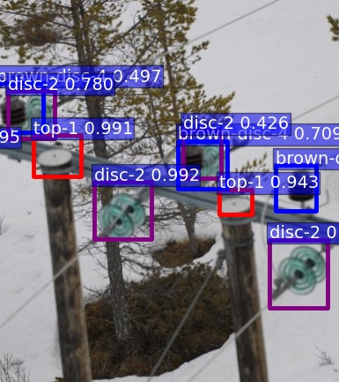

Drone-based electric grid inspector powered by deep learning
Challenge
Traditional power line inspection services are costly
Demand for low cost image scoring and support for multiple concurrent customers
Needed powerful AI to execute on a drone solution
Solution
Deep learning to analyze multiple streaming data feeds
Azure GPUs support Single Shot multibox detectors
Reliable, consistent, and highly elastic scalability with Azure Batch Shipyards
Notes:
https://blogs.technet.microsoft.com/machinelearning/2016/11/02/connected-drones-3-powerful-lessons-we-can-all-take-away/
Challenge
Power line inspection service based on drone collected imagery
Large scale image scoring service
Low cost per image
Support for multiple customers concurrently
Enable offline DNN model training
Consistency of training and deployment environments
Strategy
Offline DNN training (SSD/Caffe)
Highly elastic, scaling out solution based on Azure Batch Shipyards
Smart load distribution based on Azure Function
Consistency of environment by deploying Docker images
Flexible cost control on scalability parameters
Results
Connected Drone Product Launched on 6/1/17
Scalability at cost
Reliability and availability
Consistency with training environment

Slide 11


Increased match accuracy with image analysis
Challenge
Assist buyer search by providing accurate options of similar clothing items from catalogue
Need for improved smart-image matching capability based on color, pattern, neck style, etc.
Solution
Training data created using Bing and domain-specific images
Leveraged pre-trained ImageNet deep neural network
Accurate list of most similar clothing items using similarity metrics for apparel
Match accuracy of 74%
Notes:
Challenge
Find visually similar clothing items in a catalogue
User provides a photo of a clothing item
System compare user photo to items in clothing catalogue
List of most similar clothing items returned to user
Different measures of similarity (color, pattern, neck style, etc.)
Strategy
Dataset creation using Bing
Transfer Learning – DNN pre-trained on ImageNet. Refined network using domain specific clothing images
Similarity metric for apparel
Results
Launched as part of Brillio AI Platfrom
Introduced and being shared with various retailers
Driving 34K Azure consumption in month #1 of launch.
Accuracy of 74% Pilot

Slide 12
Pricing
Experimentation service (Public preview)
First 2 seats: Free
Seats 3 and above: $50 per seat per month
Model Management service (Public preview)
Managed models | Deployed models | Cores | Price (monthly)
20 | 2 | 4 | Free
100 | 10 | 16 | $50
1,000 | 100 | 120 | $375
10,000 | 1,000 | 800 | $2,500
Azure Machine Learning Studio and Production Web (GA)
API pricing https://azure.microsoft.com/en-us/pricing/details/machine-learning/
All services can be used independently
Notes:
Experimentation service pricing
First 2 seats: Free
Seats 3 and above: $50 per seat per month
Model Management service pricing
20 managed models / 2 deployed models / 4 cores: Free
100 managed models / 10 deployed models / 16 cores: $50 per month
1000 managed models / 100 deployed models / 120 cores: $375 per month
10,000 managed models / 1,000 deployed models / 800 cores: $2500 per month
Azure Machine Learning Studio and Production Web API pricing

Slide 13

Try it for free
Learn more
Start now
Notes:
Choose between visual drag-and-drop or code-first authoring with complete control
Use your favorite IDE, built into your favorite IDE (VS Code only @ Public Preview)
Use any framework or library and the most popular languages
Faster, easier training on industry leading Spark

